Slide 1


Cable One: Customer Churn Analysis
Team 1: Final Presentation
Team : Sreevatsan Agoramurthy, Marlee Coolidge, Yi-Wun (Wendy) Chen, Mohammad Aramimehr

Slide 2
Agenda
Objective
Customer Information Available
Current Status & Competition
Exploratory Data Analysis
Key Findings
Recommendations
Conclusion
Future scope

Slide 3
Objective
Analyze customer data to find possible causes of customer attrition.
Recommend solutions to provide CableOne to increase customer retention, improve customer experience
Enable CableOne to gain an advantage over their competitors
Provide a prediction model that we can use to predict customer churn

Slide 4
Customer Information Available
Customer data from January 2018 – October 2019 (22 months) that contains :
Demographical information
Product information
Usage information
Orders placed information

Slide 5
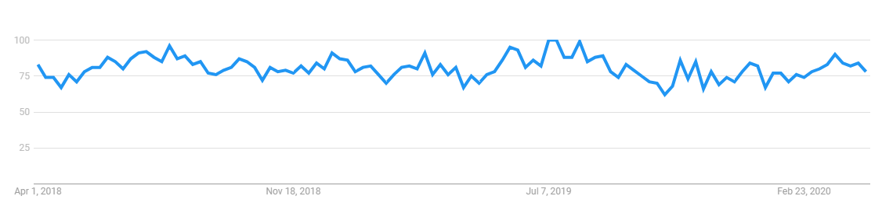
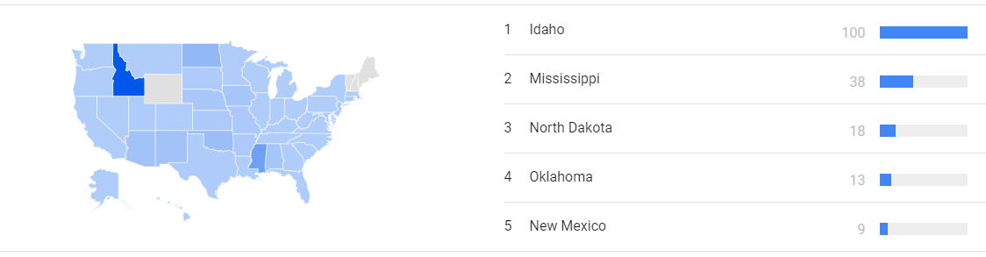
Current Status
Cable One has been reasonably popular when considering internet searches
Interest over time – Google Trends
Idaho seems to be the state where we are popular and well known as well
Interest through location – Google Trends
Sources 1. https://trends.google.com/

Slide 6
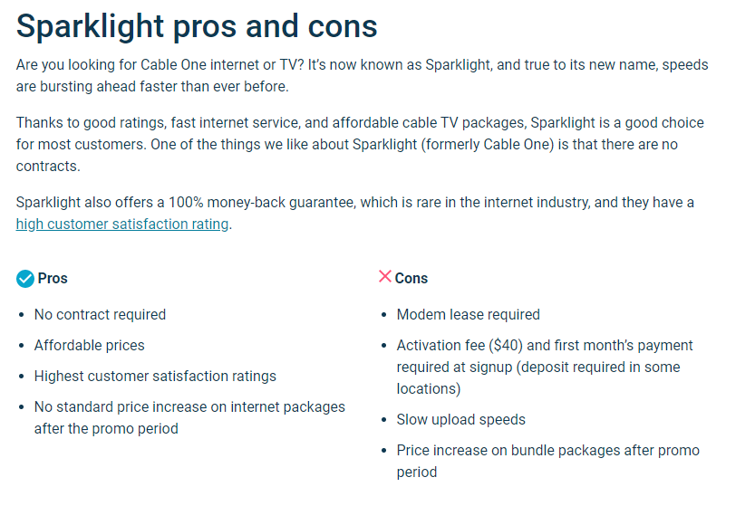

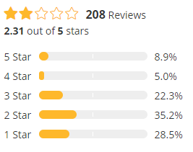
Current Status
Sources 1. https://www.sparklight.com/press/Pages/Cable-ONE-Captures-Top-Spot-in-the-West-in-J.D.-Power-Residential-Internet-Satisfaction-Study.aspx
2. https://www.highspeedinternet.com/providers/cable-one
3. https://broadbandnow.com/Sparklight-reviews

Slide 7







Competition
Let’s consider the states with the most churn – Minnesota, North Dakota and Kansas
Ranked higher
Ranked lower
Sources
1. https://www.highspeedinternet.com/

Slide 8
Glossary of terms
Churn customer – a customer leaving the services of the company
Overall Tenure – The number of months a customer has been with the company
Forced upgrade – When a customer is forced to upgrade his plans after two notices that he has exceeded his data limit
MRC – Monthly recurring charges
LifeTimeValue – The value, ranging from one star to five star, assigned by the company to reflect the value of the customer
Packages :
I – Internet
V – Video
P - Phone

Slide 9
Exploratory data analysis

Slide 10
Storyline
Overview
Effect of Overall Tenure
Effect of monthly recurring charges
Effect of promotions
Effect of promotion length remaining
Effect of forced upgrades
Forced upgrades through the overall tenure
Forced upgrades vs Product plans
Forced upgrade vs Product Offers
Effect of LifeTimeValue
Customer attrition through packages
Effect of orders

Slide 11
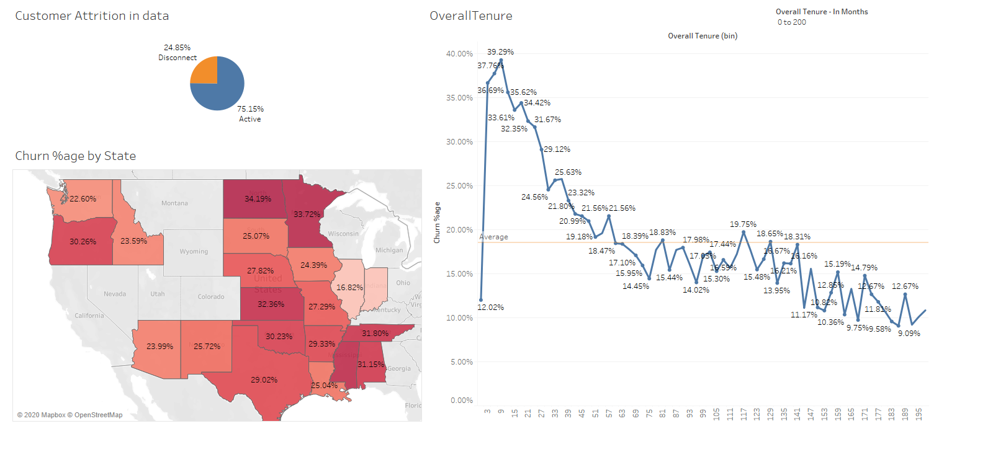
Overview

Slide 12
Storyline
Overview
Effect of Overall Tenure
Effect of monthly recurring charges
Effect of promotions
Effect of promotion length remaining
Effect of forced upgrades
Forced upgrades through the overall tenure
Forced upgrades vs Product plans
Forced upgrade vs Product Offers
Effect of LifeTimeValue
Customer attrition through packages
Effect of orders

Slide 13
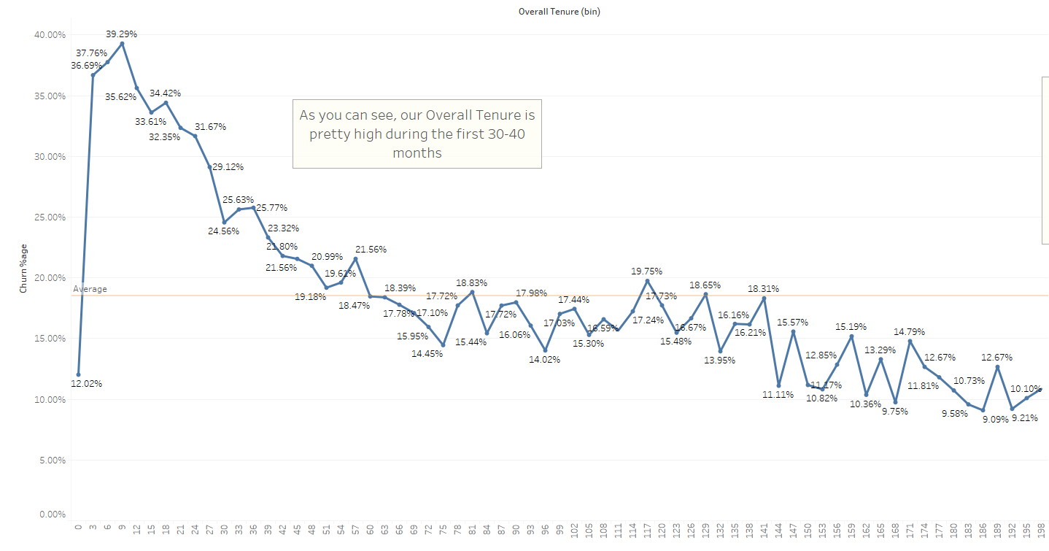
Overall Tenure

Slide 14
Storyline
Overview
Effect of Overall Tenure
Effect of monthly recurring charges
Effect of promotions
Effect of promotion length remaining
Effect of forced upgrades
Forced upgrades through the overall tenure
Forced upgrades vs Product plans
Forced upgrade vs Product Offers
Effect of LifeTimeValue
Customer attrition through packages
Effect of orders

Slide 15
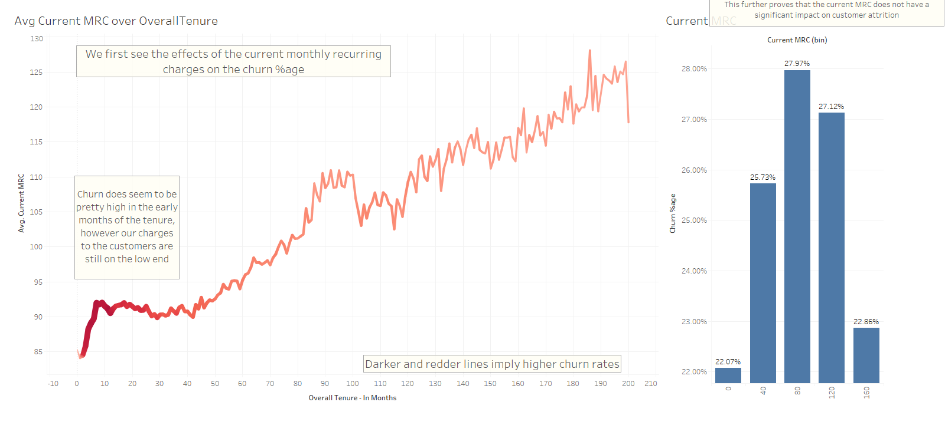
Effect of monthly recurring charges

Slide 16
Storyline
Overview
Effect of Overall Tenure
Effect of monthly recurring charges
Effect of promotions
Effect of promotion length remaining
Effect of forced upgrades
Forced upgrades through the overall tenure
Forced upgrades vs Product plans
Forced upgrade vs Product Offers
Effect of LifeTimeValue
Customer attrition through packages
Effect of orders

Slide 17
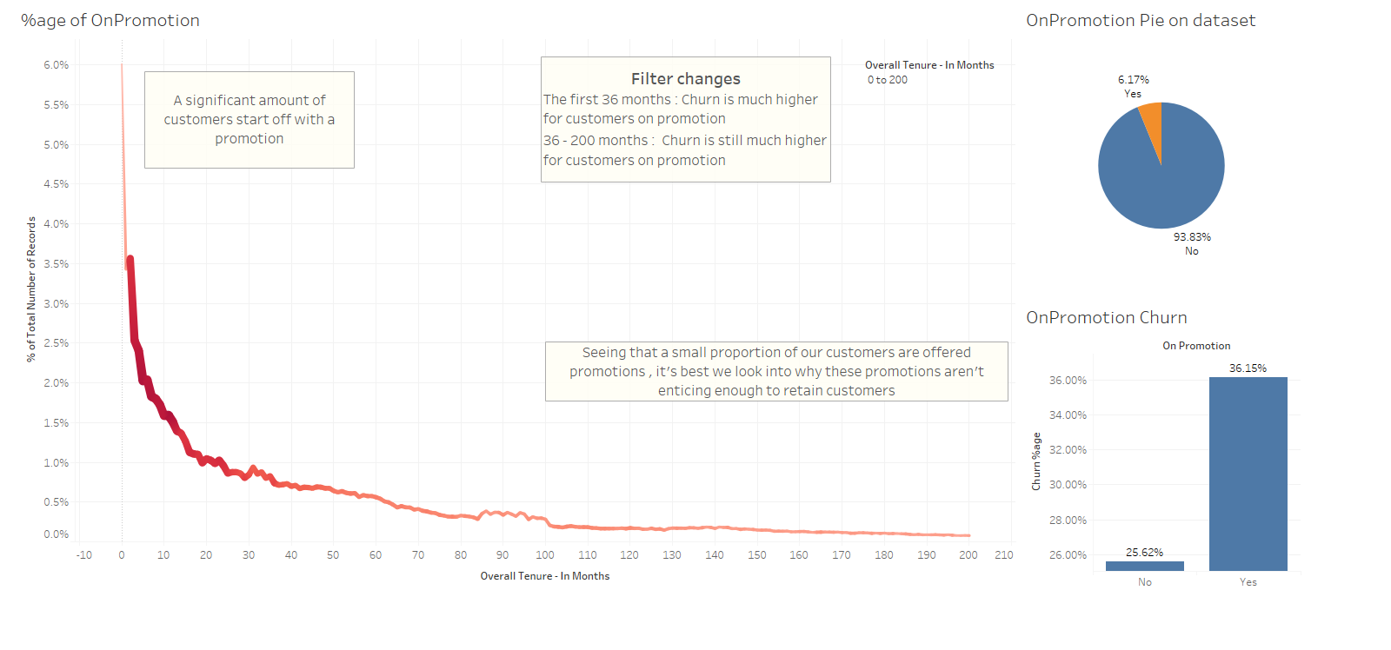
Effect of promotions

Slide 18
Storyline
Overview
Effect of Overall Tenure
Effect of monthly recurring charges
Effect of promotions
Effect of promotion length remaining
Effect of forced upgrades
Forced upgrades through the overall tenure
Forced upgrades vs Product plans
Forced upgrade vs Product Offers
Effect of LifeTimeValue
Customer attrition through packages
Effect of orders

Slide 19
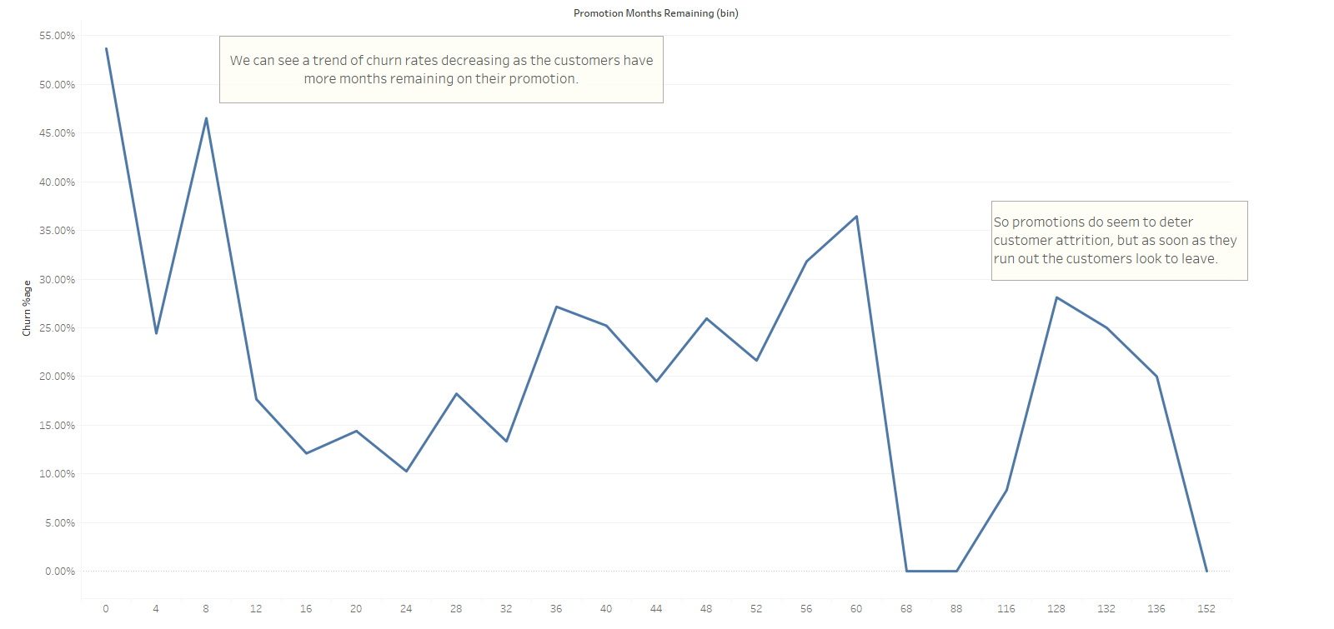
Effect of promotion length remaining

Slide 20
Storyline
Overview
Effect of Overall Tenure
Effect of monthly recurring charges
Effect of promotions
Effect of promotion length remaining
Effect of forced upgrades
Forced upgrades through the overall tenure
Forced upgrades vs Product plans
Forced upgrade vs Product Offers
Effect of LifeTimeValue
Customer attrition through packages
Effect of orders

Slide 21
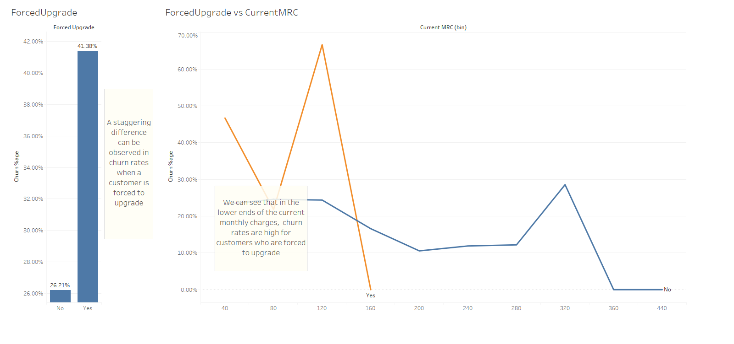
Effect of forced upgrades

Slide 22
Storyline
Overview
Effect of Overall Tenure
Effect of monthly recurring charges
Effect of promotions
Effect of promotion length remaining
Effect of forced upgrades
Forced upgrades through the overall tenure
Forced upgrades vs Product plans
Forced upgrade vs Product Offers
Effect of LifeTimeValue
Customer attrition through packages
Effect of orders

Slide 23
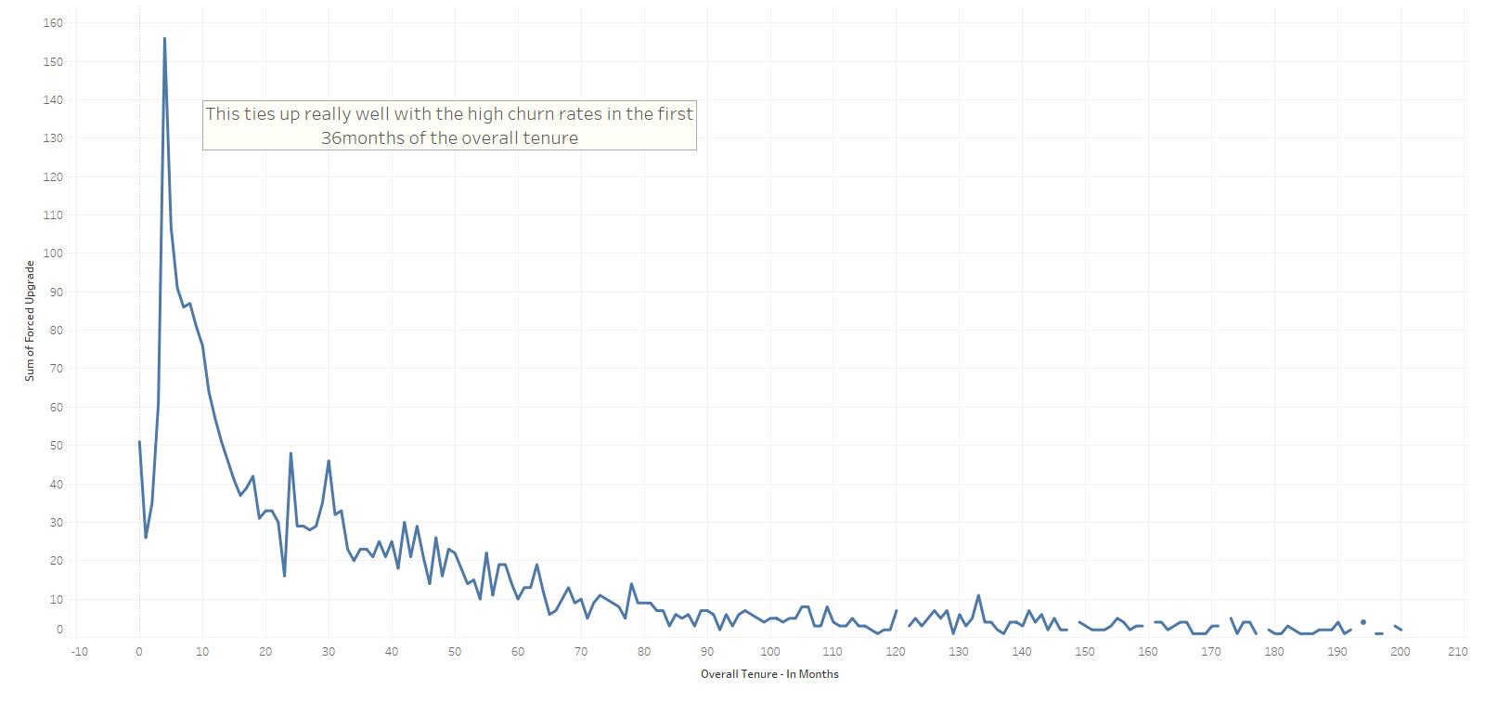
Forced upgrades through the overall tenure

Slide 24
Storyline
Overview
Effect of Overall Tenure
Effect of monthly recurring charges
Effect of promotions
Effect of promotion length remaining
Effect of forced upgrades
Forced upgrades through the overall tenure
Forced upgrades vs Product plans
Forced upgrade vs Product Offers
Effect of LifeTimeValue
Customer attrition through packages
Effect of orders

Slide 25
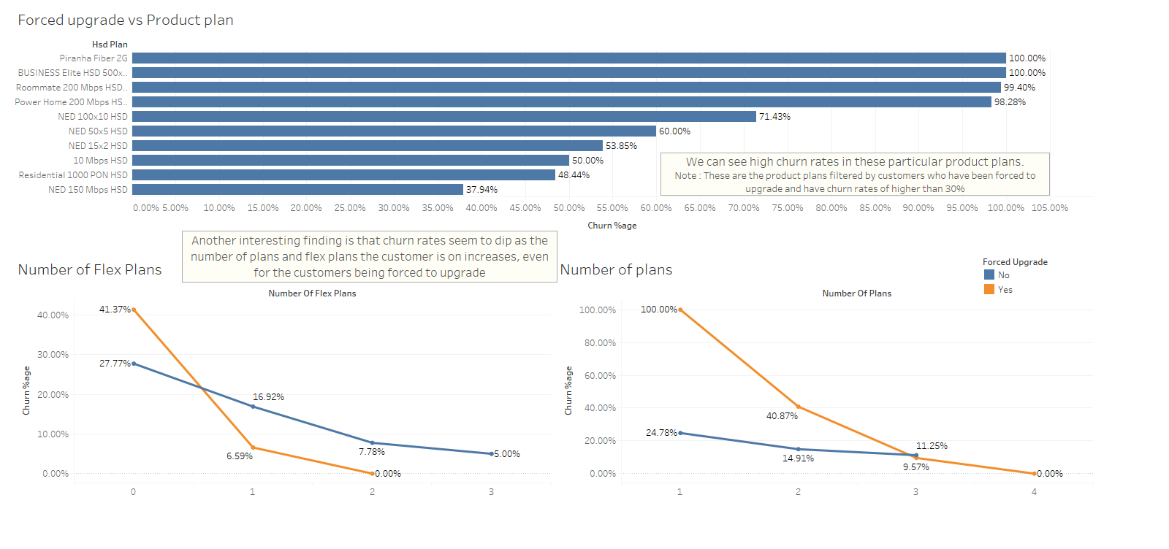
Forced upgrades vs Product plans

Slide 26
Storyline
Overview
Effect of Overall Tenure
Effect of monthly recurring charges
Effect of promotions
Effect of promotion length remaining
Effect of forced upgrades
Forced upgrades through the overall tenure
Forced upgrades vs Product plans
Forced upgrade vs Product Offers
Effect of LifeTimeValue
Customer attrition through packages
Effect of orders

Slide 27
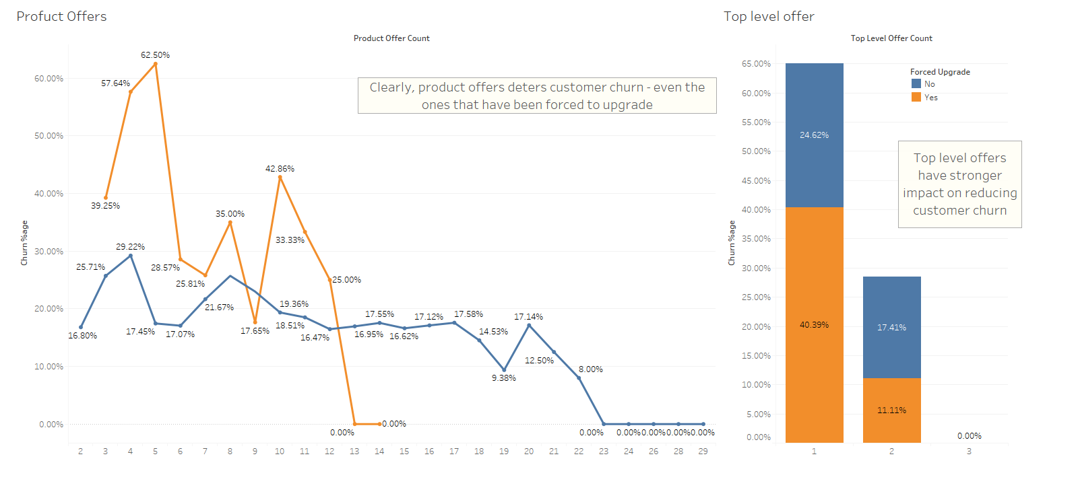
Forced upgrade vs Product Offers

Slide 28
Storyline
Overview
Effect of Overall Tenure
Effect of monthly recurring charges
Effect of promotions
Effect of promotion length remaining
Effect of forced upgrades
Forced upgrades through the overall tenure
Forced upgrades vs Product plans
Forced upgrade vs Product Offers
Effect of LifeTimeValue
Customer attrition through packages
Effect of orders

Slide 29
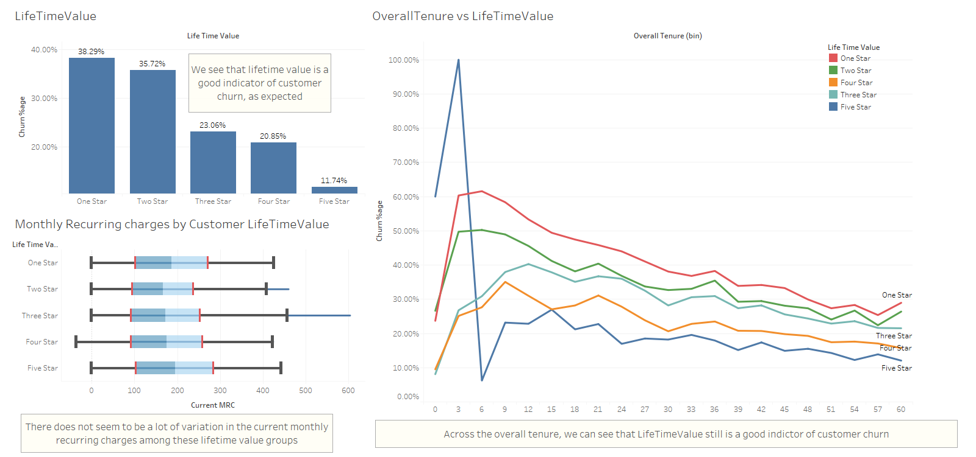
Effect of LifeTimeValue

Slide 30
Storyline
Overview
Effect of Overall Tenure
Effect of monthly recurring charges
Effect of promotions
Effect of promotion length remaining
Effect of forced upgrades
Forced upgrades through the overall tenure
Forced upgrades vs Product plans
Forced upgrade vs Product Offers
Effect of LifeTimeValue
Customer attrition through packages
Effect of orders

Slide 31
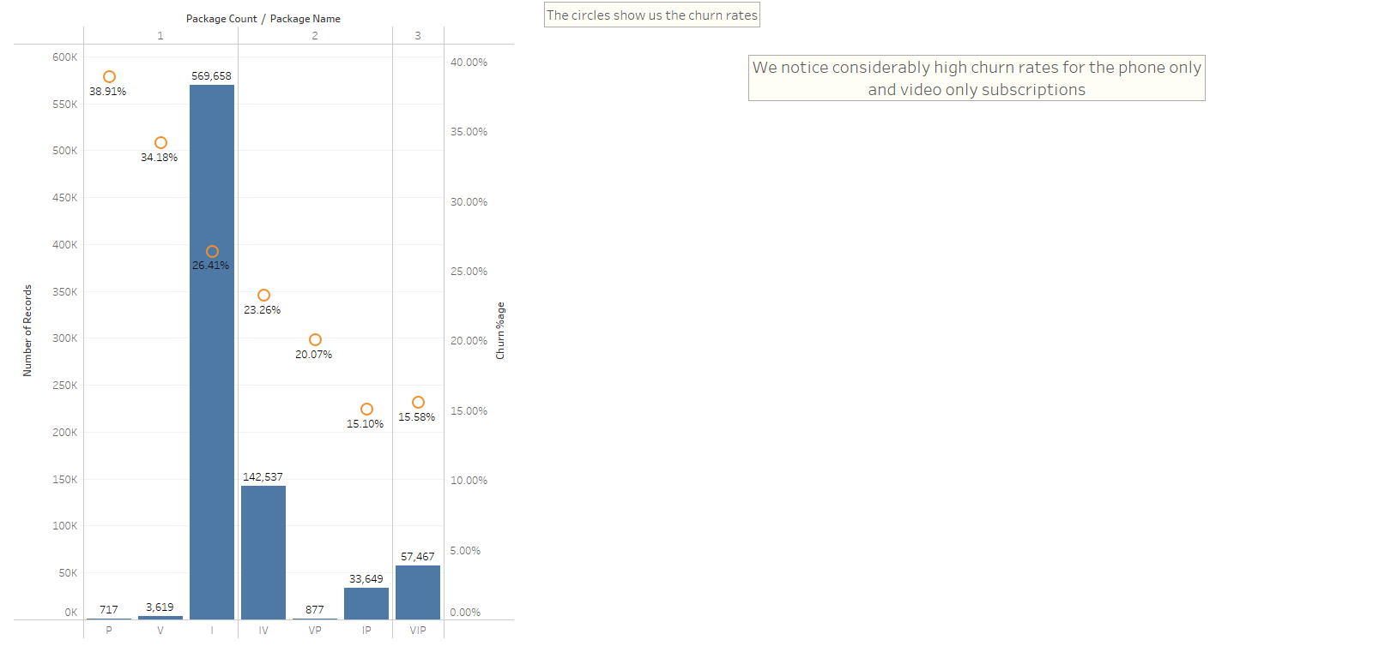
Customer attrition through packages

Slide 32
Storyline
Overview
Effect of Overall Tenure
Effect of monthly recurring charges
Effect of promotions
Effect of promotion length remaining
Effect of forced upgrades
Forced upgrades through the overall tenure
Forced upgrades vs Product plans
Forced upgrade vs Product Offers
Effect of LifeTimeValue
Customer attrition through packages
Effect of orders

Slide 33
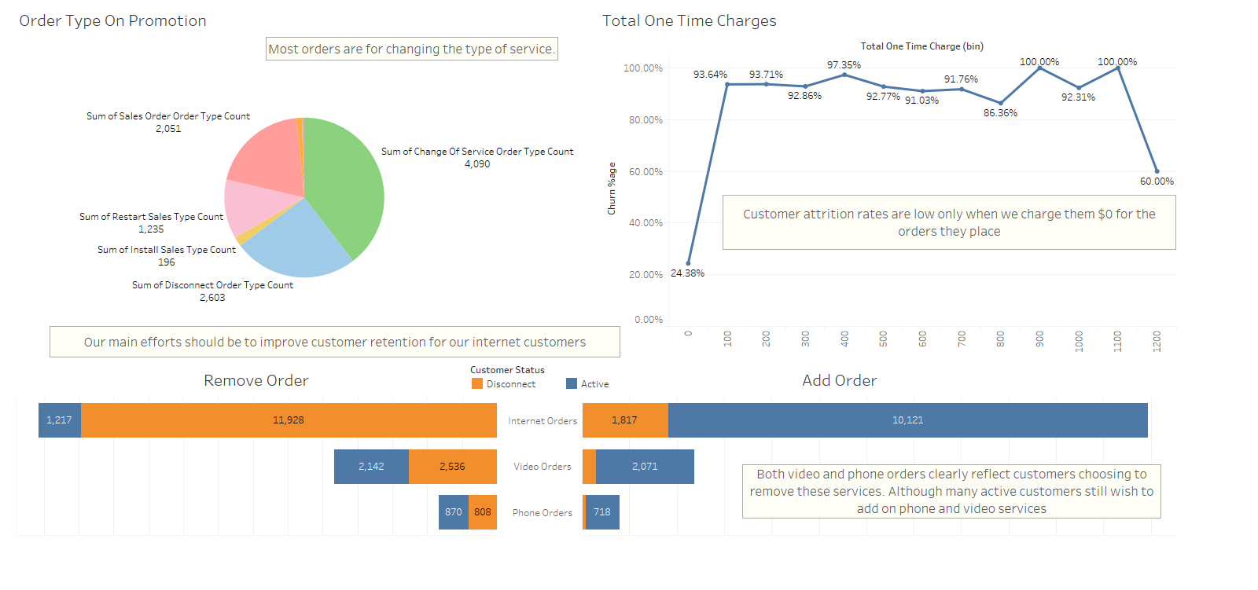
Effect of orders

Slide 34
Key Findings
High attrition rates in the first 36 months of a customer’s tenure
Promotions help with customer retention, but lead to churn when promotion period ends
Forced upgrade cause major customer churn
The more plans a customer is on, the less likely they are to leave
LifeTimeValue is a strong indicator of customer churn
Phone and Video services see significantly higher rates of churn
One Time charges seem to cause customer churn

Slide 35
Recommendations
Customer satisfaction does seem to be high, but we have to consider improving customer experience in the first 3 years of their tenure.
An increase in number of promotions offered or reducing the price reduction when a customer is on a promotion
Forced upgrade is a major problem
Educate sales representatives to better understand customer needs thereby selling appropriate plans
Drop plans that have a low data and bandwidth limit
Provide customers with a ‘Pay as you go’ plan in the first 2 months to gauge their usage requirements
Offer promotion immediately after a customer is forced to upgrade
Focus on selling more bundled packages

Slide 36
Recommendations
Offer phone and video services only as a bundle with internet
Implement zero one-time charges as much as possible
Customers are satisfied with low rates, offers us some wiggle room to reduce one time charges
Refrain from offering promotions during the first 1-2 years of a customer’s tenure
Reduces cost to company when a large proportion of customers leave in the beginning anyway
Instead offer promotions after 24-30 months to keep the customer enticed

Slide 37
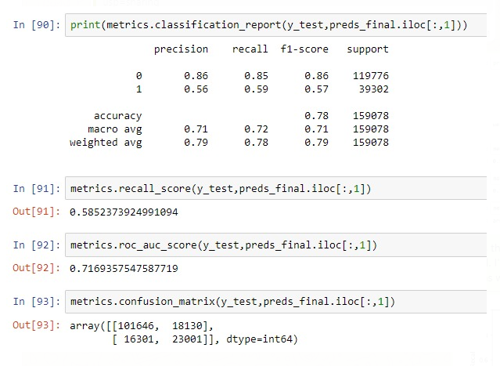
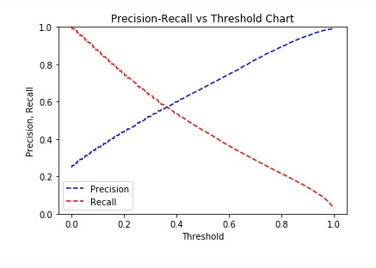

Prediction Model
Random Forest Classifier

Slide 38
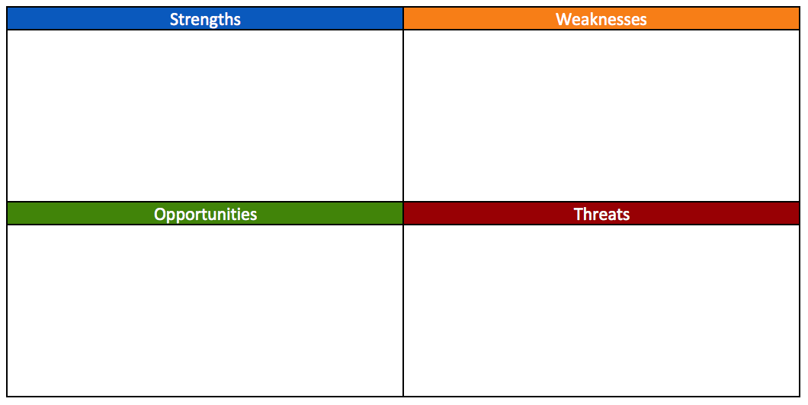
Conclusion
Low Pricing
Customer Satisfaction
Wide range of plans
No contracts required
High churn rates
Marketing strategies
Flexibility of plans
COVID-19 crisis increases demand
Large internet corporations have poor customer service
Market is still untapped in rural areas where company already has presence
Increase in popularity of video streaming services like Netflix, Amazon Prime Customer Satisfaction
Competition is very intense

Slide 39
Future work
Customer surveys before & after
Promotion
Product offers
Forced upgrade
Exit
Prediction model – Time series classification too complex
Obtaining marketing data to supplement churn analysis by geographical region

Slide 40
Thank you!
MSBA Capstone Team 1

